Slide 1
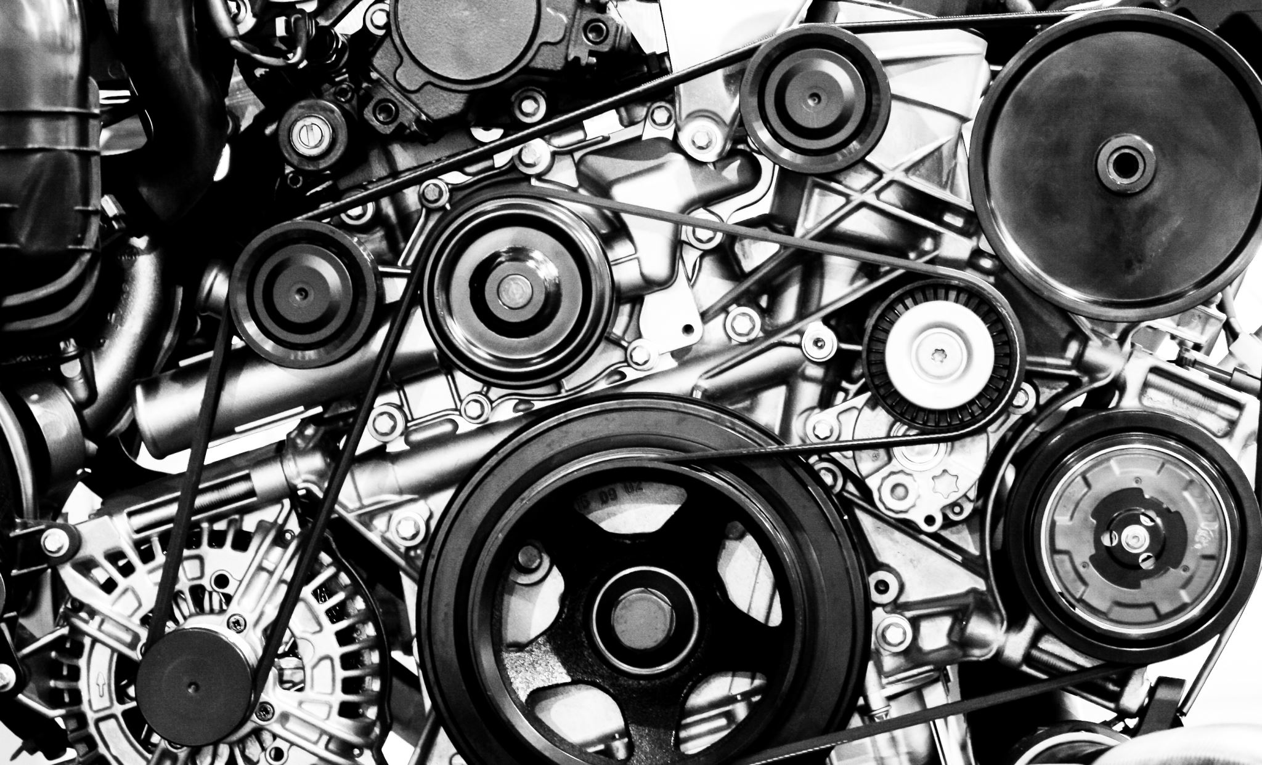
MECHANICAL CAD DESIGN PORTFOLIO
BY
LADIPO TAIWO (AMIMechE)(M.ENG MECHANICAL)
MECHANICAL DESIGN ENGINEER

Slide 2
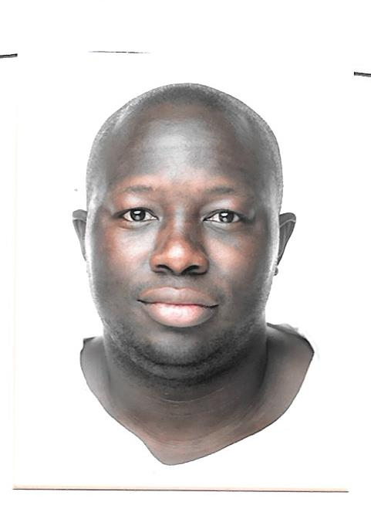
About me
I'm a Mechanical Design Engineer with 5+ years' experience in 3D CAD modeling, simulation, and rapid prototyping. I excel in crafting clear technical documents. Passionate about sustainable design, I integrate environmental considerations into all projects. Expertise includes material extrusion-based additive manufacturing.
In my CV, I can only present a snapshot of my skills and experiences. However, This portfolio highlights some of my most exciting work, showcasing my contributions to various innovative projects
Technology and software's might change rapidly, but the principles of CAD design comes from the foundation engineering drawing (drafting) and Understanding mind
LADIPO TAIWO (AMIMechE)

Slide 3
contents
Skills and Experience:
Project: Stress Analysis of two stroke engine using Autodesk Inventor
Project: Modification of tabletop material (3D) extrusion printer
Project: design and optimization of PET bootle injection moulds using SolidWorks Cam software
Publication:Mechanical and Tribological Performance of Polyetheretherketone Composites using Tabletop 3D Printer
Publication: Experimental Analysis of Crystallinity and Mechanical Properties for Fused Filament Printed Polyetherketone Composites.
Publication: Solid Additives and their Lubrication Effects on Polyetheretherketone Polymers – A Review.

Slide 4
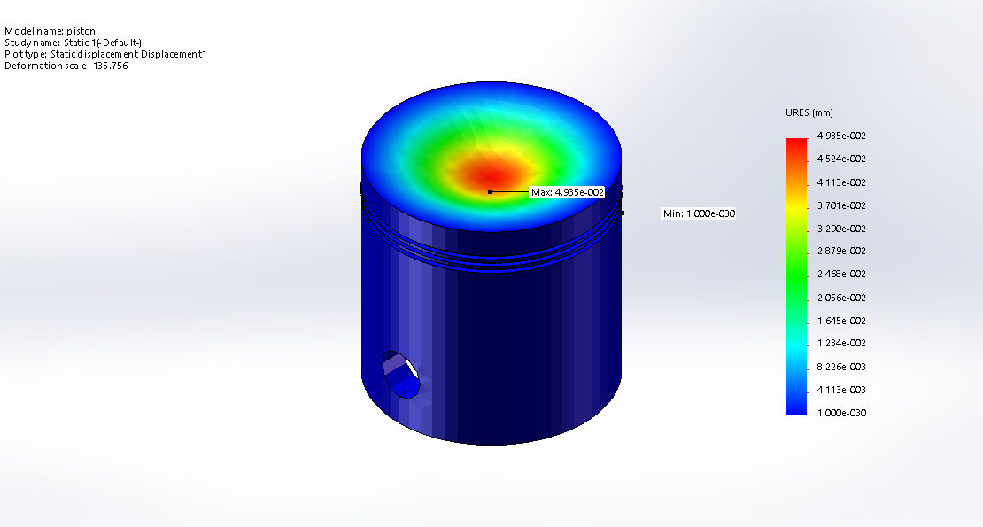
Project: Stress Analysis of two stroke engine using Autodesk Inventor Software :Autodesk Inventor 2014 Year 2014
WHAT ?
Determination of loading effects on two stroke motorcycle engineer
Minimize human error and design recommendation and optimization
HOW?
Design of piston in Autodesk inventor
Assumption and material selection
Constraints and mesh

Slide 5
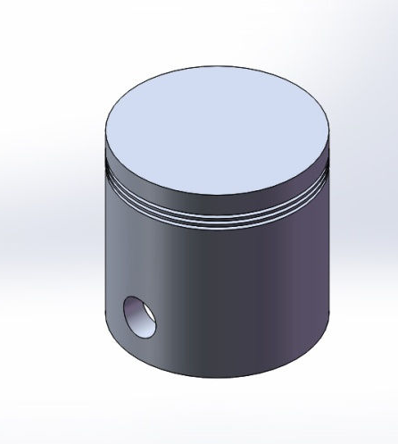
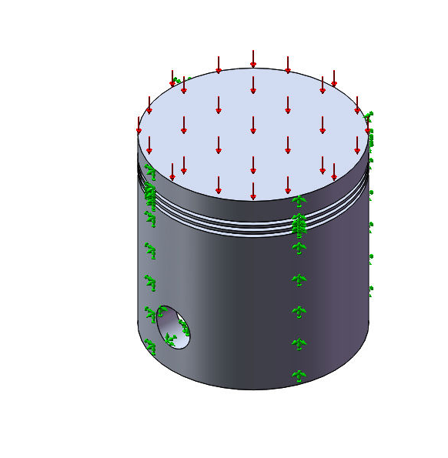
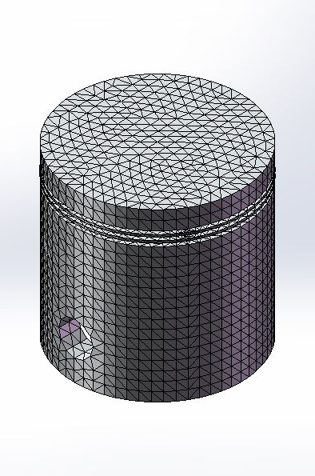
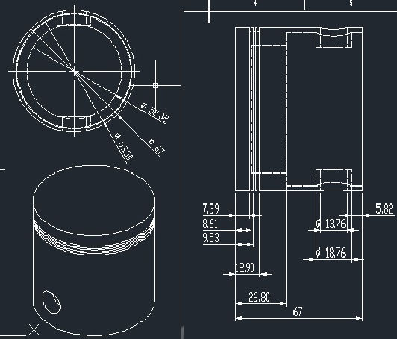
Project: Stress Analysis of two stroke engine using Autodesk Inventor
Resultsng
2d dimensions of the Piston
3D model of the Piston
Constraints and static loading
Mesh of the piston

Slide 6
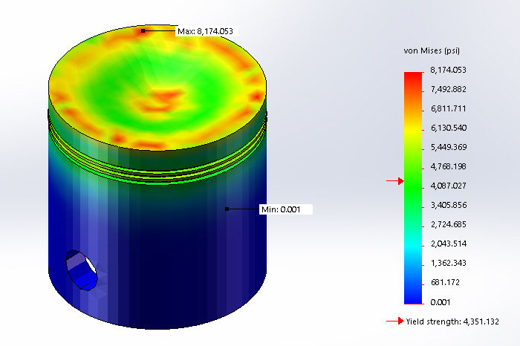
Project: Stress Analysis of two stroke engine using Autodesk Inventor
Results
Von misses (static) stress on the piston
Static displacement of the piston

Slide 7
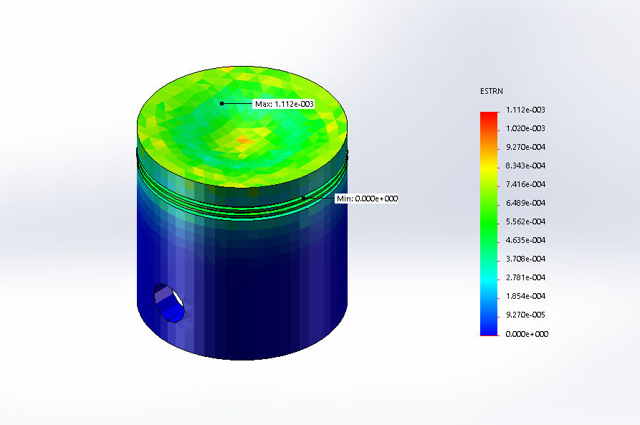
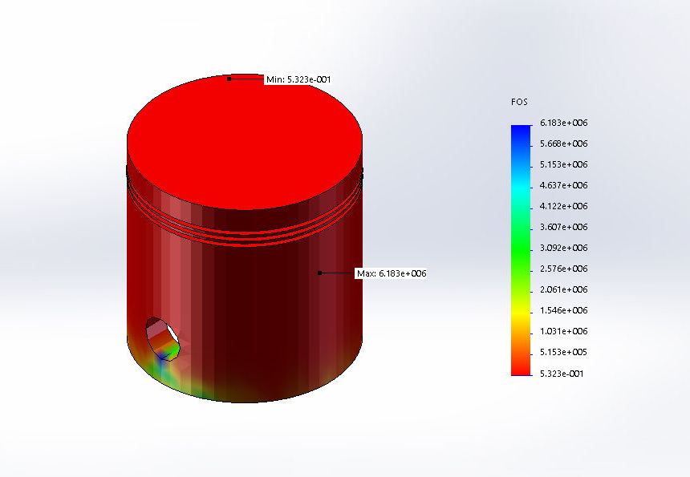
Project: Stress Analysis of two stroke engine using Autodesk Inventor
Results
Static Strain of the Piston
Factor of safety

Slide 8

Project: Modification of tabletop material (3D) extrusion printer
Software used
SolidWorks
MS Vs Code
Andrino IDE,
Creo3
Slicr3
WHAT ?
Modification of existing table 3D printer and filament extruder
Increase temperature limitation of printer and filament extruder
Custom filament production with high temperature requirements using tabletop filament extruder
HOW?
Change/ adapt printer Extruder from Bodwen Style to MicroSwiss Direct drive
Design of Extruder carrier in Solidworks
Change power and temperature setting using VsCode with andrino IDE
replacement Printer logic board to Rumba 32-bit board to allow modification
Installation and reprograming of Stepper motors
Design of 3D Print samples using creo 3
3D Print sample slicing using Slicr3
Testing and validation of printed samples

Slide 9
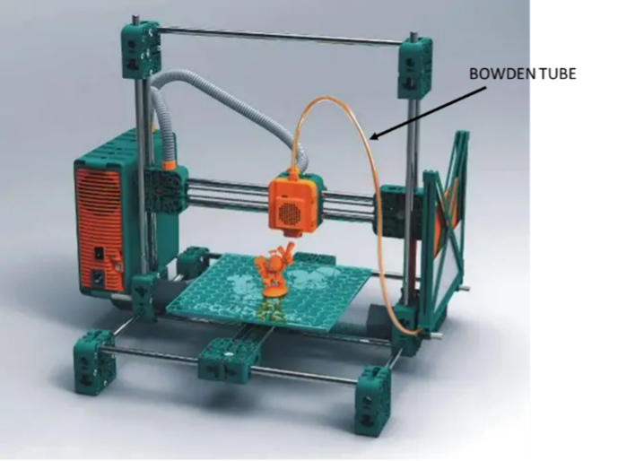
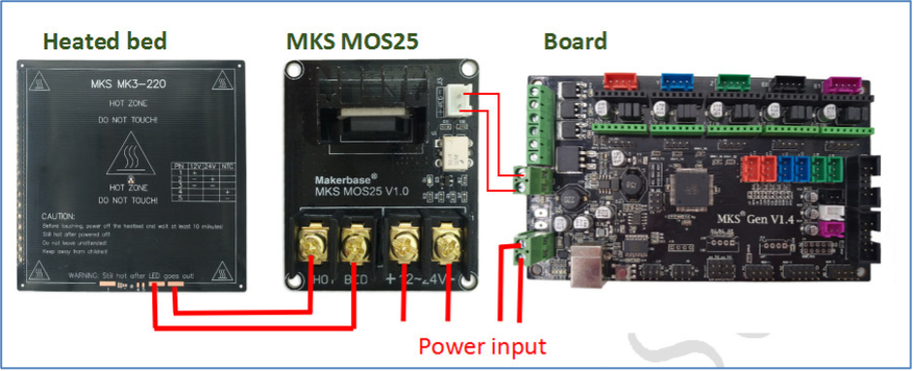
results

Slide 10
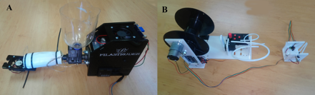
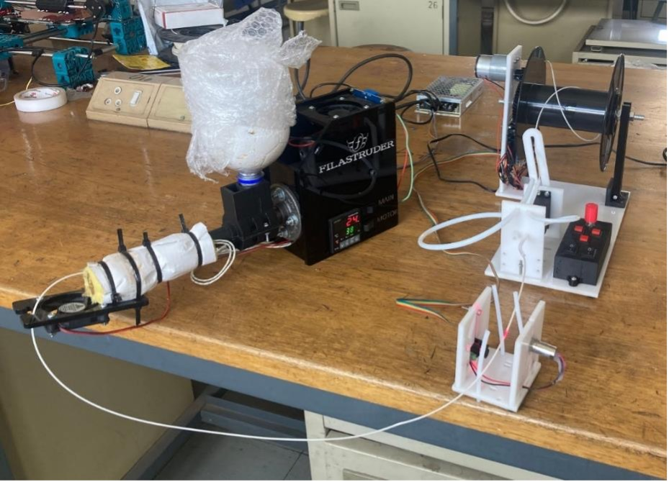
results

Slide 11
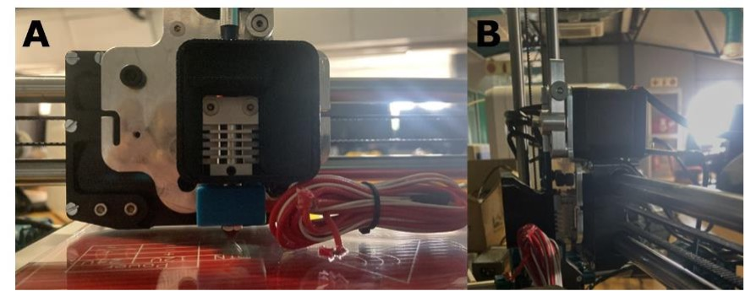
results

Slide 12
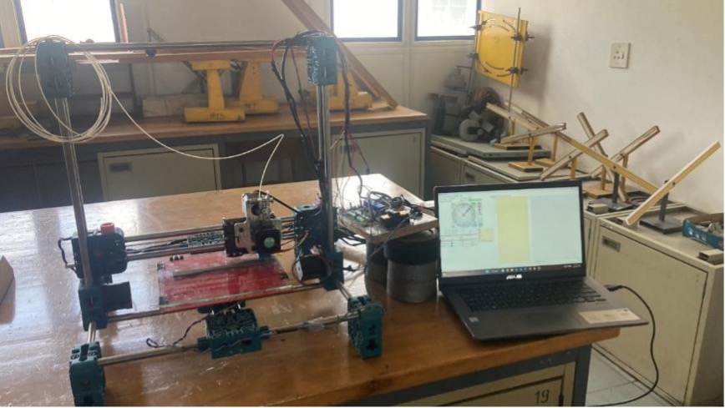
results

Slide 13
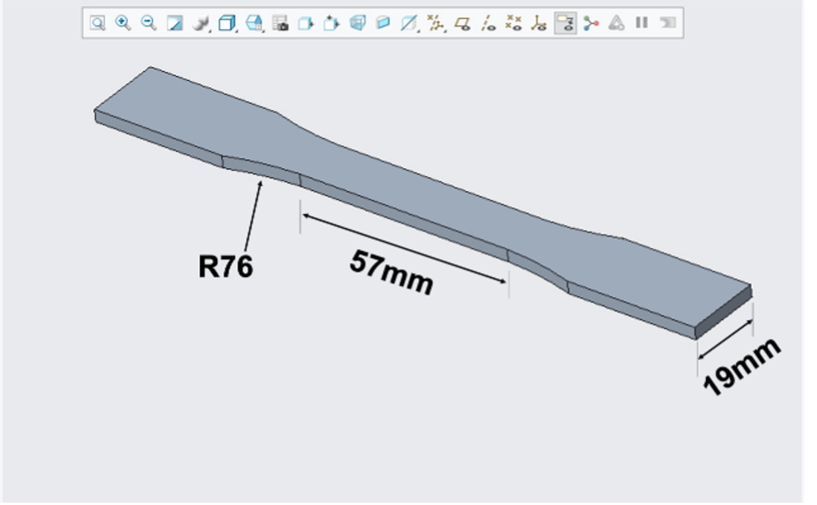
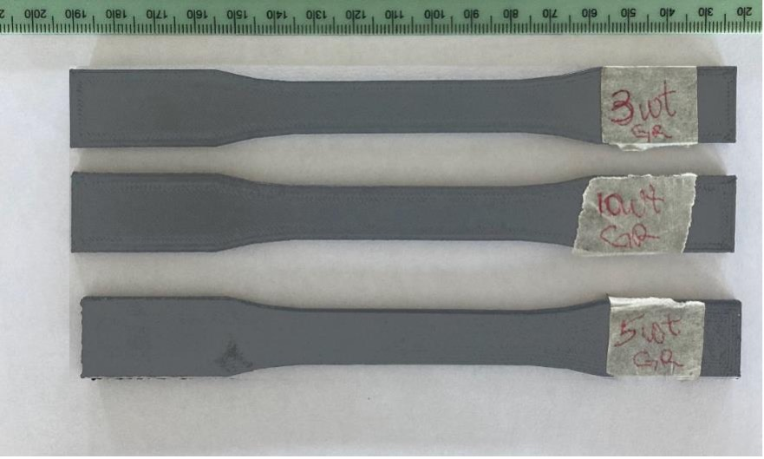
results

Slide 14
Publication:Mechanical and Tribological Performance of Polyetheretherketone Composites using Tabletop 3D Printer
International Journal of Engineering Trends and Technology, 71(11),136–147. https://doi.org/10.14445/22315381/IJETT-V71I11P215
Abstract This article investigates the mechanical and tribological properties of 3D-printed Polyetheretherketone (PEEK) composites containing Molybdenum disulphide MoS2 and graphite fillers. 7 filament strands were created with varying weight percentages to print 35 dog bones and 7-disc samples for further analysis. The results showed a 61% increase in tensile strength of MoS2-filled PEEK (MoS2/PEEK) composite compared to plain PEEK. The filled PEEK had a reduced frictional response time and an average coefficient of friction of about 36% and 69 %, respectively. MoS2/PEEK showed superior wear resistance of about 50% compared to graphite-impregnated PEEK (Gr./PEEK).
Keywords FFF printing, Graphite, MoS2, PEEK composites, Solid lubricants.

Slide 15
Publication: Experimental Analysis of Crystallinity and Mechanical Properties for Fused Filament Printed Polyetherketone Composites.
Journal of Engineering, 2023, 6687928. https://doi.org/10.1155/2023/6687928
Abstract
The objective of this article is to examine the impacts of molybdenum disulphide (MoS₂) and graphite-filled (Gr) polyetheretherketone (PEEK) composites that have been fabricated through 3D printing on their mechanical properties and crystallinity. Seven samples and thirty-five dog bones were produced using different filament strands to conduct the analysis. Before extrusion into filaments, the solid lubricants, MoS₂, and graphite were uniformly dispersed within the PEEK through mechanical blending. At a concentration of 10 wt.%, the PEEK/MoS₂ composites exhibited the highest tensile strength, measuring approximately 104 MPa, while the PEEK/Gr composites displayed the lowest tensile strength at the same concentration, approximately 36 MPa. In addition, the PEEK/MoS₂ composites demonstrated better elongation, approximately 4.7%, compared to the PEEK/Gr composites, which exhibited approximately 2.3% elongation. X-ray diffraction (XRD) data revealed that neither MoS₂ nor graphite significantly interacted with the PEEK matrix. The degree of crystallinity, as determined by density matrices, indicated that the printed PEEK composites possessed a higher level of crystallinity, approximately 62% at a concentration of 5 wt.%, than the calculated values. This suggests that the filament-making and 3D printing processes had an annealing effect. The significance of solid lubricant content and dispersion in shaping the mechanical properties and crystal formation of 3D-printed PEEK composites is emphasized in this study. Furthermore, this research provides valuable insights for optimizing PEEK-based materials for various applications.
keywords
Additive Manufacturing (AM), 3D printing, Material Extrusion(ME),Fused Filament Fabrication(FFF),Fused deposition Modelling (FDM), Polyetheretherketone (PEEK), solid lubricants, laminar solid

Slide 16

Publication: Solid Additives and their Lubrication Effects on Polyetheretherketone Polymers – A Review.
International Journal of Engineering Research and Technology, 13(12), 4262–4268. https://doi.org/10.5281/zenodo.6368734
Abstract
This review investigates and analyses the effects and usage of solid lubricants on high melting polymer printed via fused filament fabrication (FFF). The analysis indicated that most FFF printed parts suffer non-uniformity in mechanical properties, and such printed pieces are generally weaker than conventionally produced counterparts. About 95% of research on FFF was about solving the weakness and non-uniformity of mechanical properties, with 98% ignoring the tribological effects. Addition of laminar solids to polymer improves not only the tribological properties but also some mechanical properties. Nevertheless, the effects of laminar solid results on polymer might not be predictable as the outcome depends on relative properties of such polymer, solids and FFF processing parameter. It is suggested that further research should be carried out on the effects of laminar solids on FFF processed polymer.
Keywords
Additive Manufacturing (AM), 3D printing, Material Extrusion(ME),Fused Filament Fabrication(FFF),Fused deposition Modelling (FDM), Polyetheretherketone (PEEK), solid lubricants, laminar solid

